Slide 1

Artificial Intelligence Techniques for Load Forecasting in an Electric Utility
CSE(AI)-B
GROUP 14
EEE & UID
GROUP MEMBER
VARSHITHA
MEERA NAMBIAR
YASHWANTH V
ROLL NO:
CB.SC.U4AIE24114
CB.SC.U4AIE24132
CB.SC.U4AIE24160

Slide 2

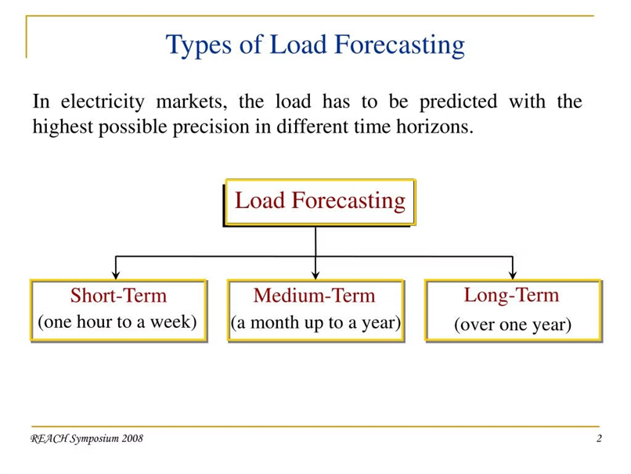
INTRODUCTION:
Load forecasting predicts future electricity demand using weather, season, and historical data to ensure efficient energy management.
Short-term forecasting estimates demand from a few hours to days ahead for better grid management.
Accurate predictions optimize power generation and distribution, reducing costs, preventing energy waste, and enhancing efficiency.
Ensures grid stability and reliability by balancing supply with demand, preventing shortages or overloads.
AI automation simplifies load forecasting, cutting down on manual work and allowing resources to focus on more important tasks.

Slide 3
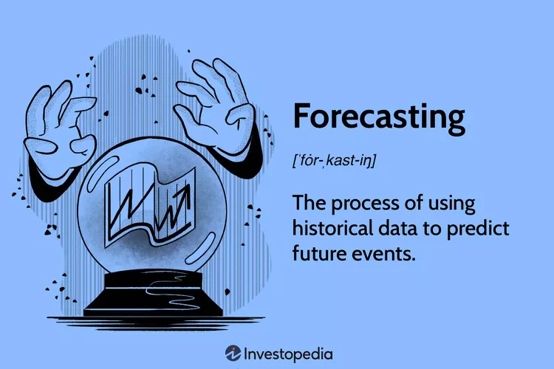
Problem Statement
Inaccurate Predictions: Traditional methods struggle to forecast short-term electricity demand accurately.
Sudden Demand Fluctuations: Rapid and unpredictable changes in consumption patterns make forecasting complex.
Operational Challenges: Inaccurate forecasts lead to power imbalances, higher costs, and inefficient resource allocation.
Need for Smarter Forecasting: A data-driven AI approach is essential to enhance prediction accuracy and optimize energy management.
Objectives
To develop an AI-based load forecasting model using ANN and SVM.
To improve the accuracy of short-term electricity demand forecasts.
To compare the performance of ANN and SVM for load forecasting.
To help electric utilities make better decisions with accurate load forecasting.

Slide 4
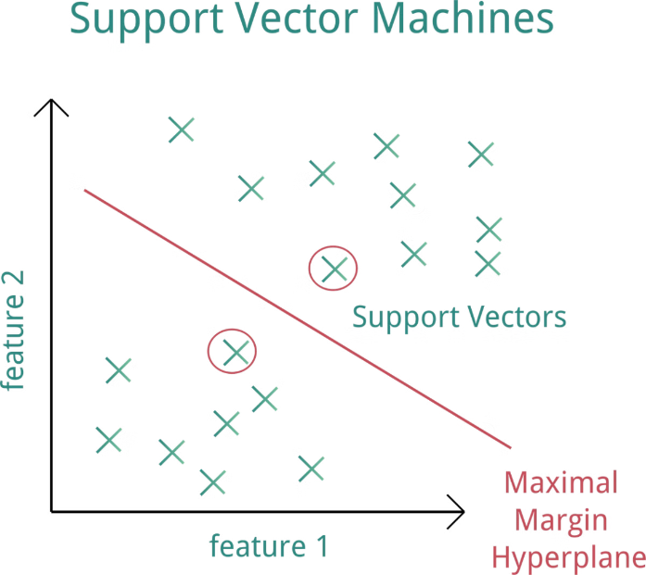
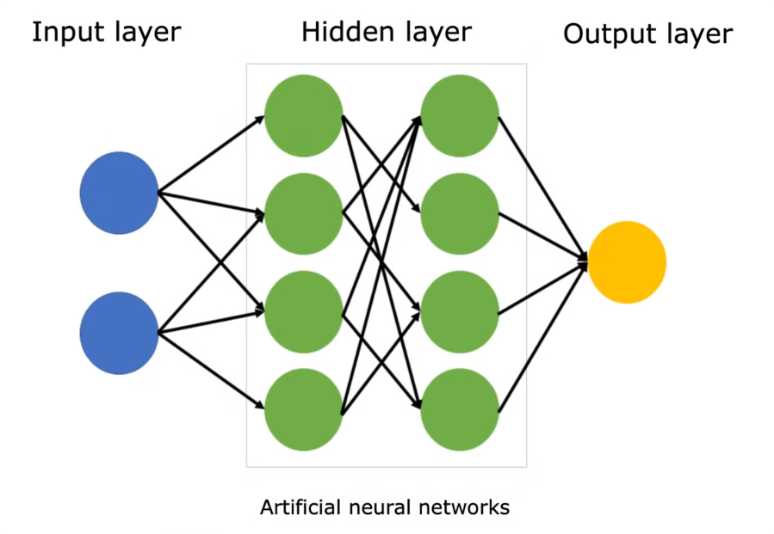
SUPPORT VECTOR MACHINE:
A supervised learning algorithm that finds the optimal hyperplane to separate different classes (for classification) or predict continuous values (for regression). Support Vector Regression (SVR) for regression tasks, with kernels like Linear, Polynomial, RBF (Radial Basis Function). Maximizes the margin between data points and the decision boundary using support vectors. Uses a kernel trick to handle non-linear data.
ARTIFICIAL NUERAL NETWORK:
A computational model inspired by biological neurons that learns patterns from data through interconnected layers of artificial neurons.
Feedforward Neural Network (FNN) with backpropagation for training. Can include multiple layers (deep learning).
Processes input through multiple layers (input → hidden → output), applies activation functions, and updates weights using backpropagation & gradient descent.

Slide 5




Comparative Analysis of ANN and SVM Techniques
⭐Accuracy
1
ANN provides highly accurate predictions, closely matching actual load.
SVM predictions are close but slightly less accurate than ANN.
⭐Generalization
2
ANN tends to generalize well on large datasets but needs more training data to avoid overfitting.
SVM generalizes better on small to medium datasets and is less prone to overfitting with the right kernel selection.
⭐Data Handling
3
ANN performs well with large datasets and complex patterns.
SVM is effective for smaller datasets and handles high-dimensional data efficiently.
⭐Training Efficiency:
4
ANN requires more time for training due to complex network structures.
SVM is faster in training, especially with smaller datasets.

Slide 6


Data Collection
Data Preprocessing
Splitting the dataset for training and testing
Defining the Model
Train the Model
Evaluating

Slide 7
Methodology for Load Forecasting Using SVM:
Data Preparation
Load historical electricity demand data and relevant weather features (e.g., temperature, humidity, wind speed,Liquid precipitation in Tocumen, Panama city ).
Perform data cleaning and standardization using Z-score normalization to ensure proper scaling.
Split the dataset into 80% training and 20% testing for model evaluation.
Support Vector Machine (SVM) for Load Forecasting
Model Training Using SVR:
We use Support Vector Regression (SVR) because: It captures non-linear relationships in load demand. It ignores small fluctuations to focus on overall trends. It works well for small to medium datasets compared to deep learning models.

Slide 8
Choosing the RBF Kernel
The Radial Basis Function (RBF) kernel is used because: It maps data into a higher-dimensional space to capture complex demand patterns. It handles seasonal variations in load demand.
Hyperparameter Optimization 🔹 We tune three key parameters to improve accuracy: C (Regularization Parameter) – Controls how much error is allowed. ε (Epsilon Tube Width) – Defines the margin within which small errors are ignored. γ (Gamma in RBF Kernel) – Determines the influence of individual data points. 🔹 MATLAB’s fitrsvm function automatically optimizes these parameters.
Model Prediction & Performance Evaluation
The trained SVR model predicts load demand on test data.
Performance Metrics: Mean Squared Error (MSE) – Measures average squared difference between actual and predicted values. Mean Absolute Error (MAE) – Measures how much predictions deviate from actual values. R-Squared (R²) – Measures how well the model explains variation in demand.

Slide 9
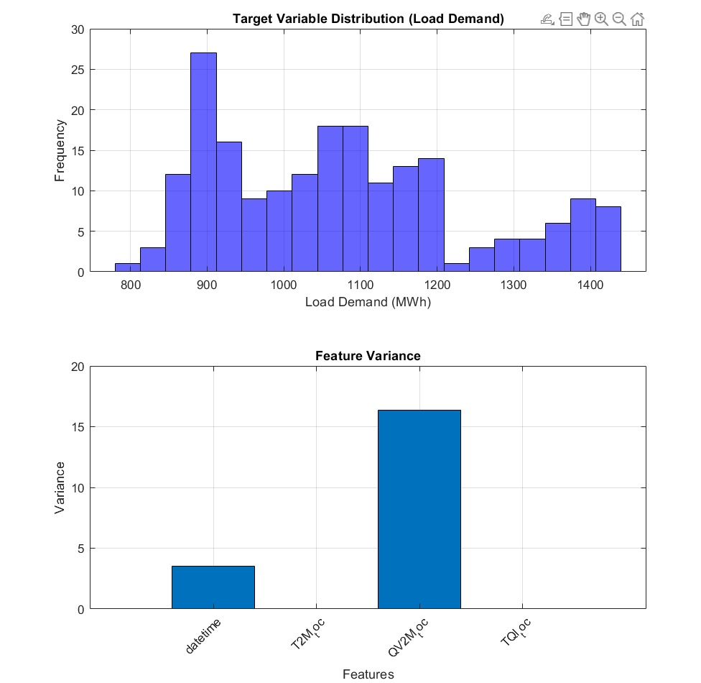
Results(At present):
First Graph: Load Demand Distribution (Histogram)
Plots how often different Load Demand (MWh) values appear in the dataset.
X-axis → Load Demand (MWh), Y-axis → Frequency (how many times it occurs).
Second Graph: Feature Variance (Bar Chart)
Plots the variance (spread) of each feature in the dataset.
X-axis → Features (e.g., Temperature, Humidity), Y-axis → How much the values change.

Slide 10
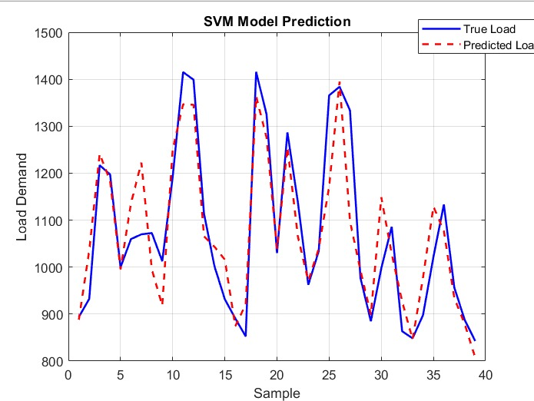
SVM(SUPPORT VECTOR MACHINE):
Graphical Analysis:
Plot true vs. predicted load demand to see model accuracy
Histogram of prediction errors helps assess the error distribution.
The model is performing well but has some errors in predicting sharp demand changes. 🔹 There might be slight overfitting or underfitting, which could be improved by adjusting SVM parameters (C, γ, ε).
These differences indicate prediction errors, which could be caused by:
Sudden fluctuations in demand.

Slide 11
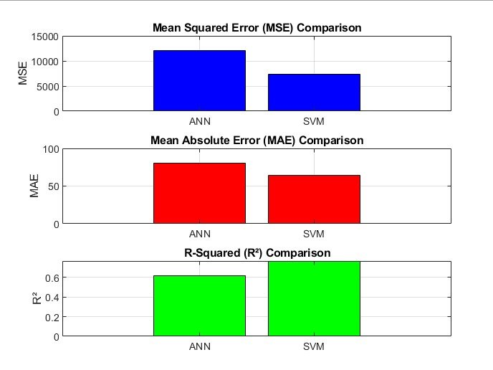
Comparison with ANN:
🔹 SVM vs. ANN performance metrics (MSE, MAE, R²) are compared to determine which model performs better.
Interpretation of the Graphs
MSE Bar Graph → Lower bar = Better
MAE Bar Graph → Lower bar = Better
R² Bar Graph → Higher bar (closer to 1) = Better

Slide 12
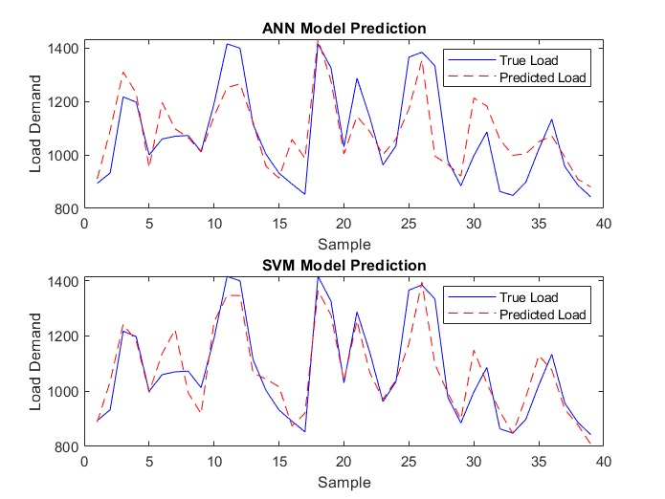
Comparison with ANN:
Plot true vs. predicted load demand to see model accuracy
Both models capture the general trend of the actual load demand.
ANN shows some deviations, especially in high peak values.
SVM appears to follow the trend slightly better in some areas, but both models show errors in prediction.

Slide 13
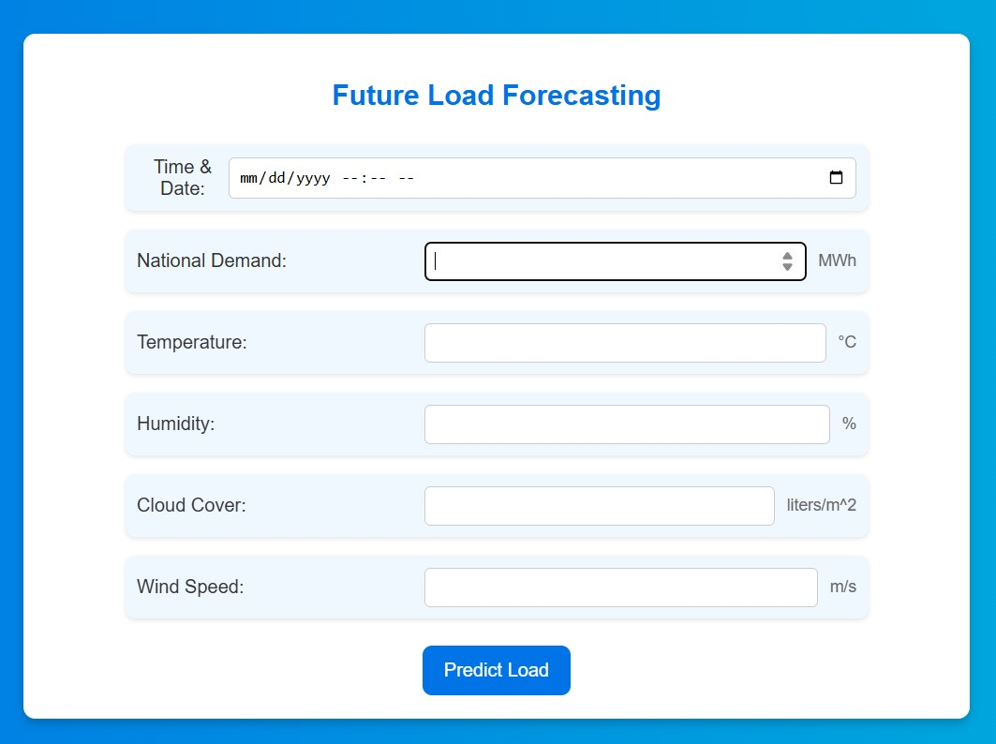
User Interface Design
A simple webpage lets users input data and get predictions instantly.
First interface allow users to enter their personal details which then directs to new page where user have to enter the parameters to predict the future load electricity.

Slide 14
Challenges and Limitations of AI-based Load Forecasting
Data Quality
1
AI models need accurate and complete data to make correct forecasts. If the data is poor or missing, it can cause wrong and biased predictions.
Overfitting
2
AI models can become too focused on the training data, making it hard for them to predict accurately when faced with new data.
Interpretability
3
AI models can become too focused on the training data, making it hard for them to predict accurately when faced with new data.

Slide 15

Future Scope
1
2
Integration
Advancements
Future research will focus on integrating AI with other technologies, such as smart grids and demand response, for improved load management.
The development of new and advanced AI techniques, such as deep learning, holds promise for enhancing load forecasting capabilities.
3
Benefits
By leveraging AI, electric utilities can achieve greater operational efficiency, ensure grid reliability, and optimize energy resources, benefitting both the industry and consumers.

Slide 16
THANKYOU...

